Slide 1
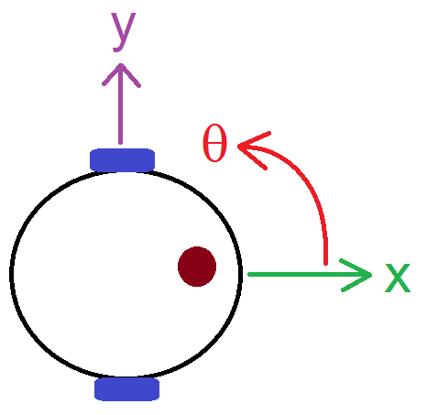
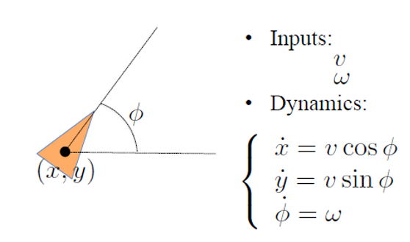
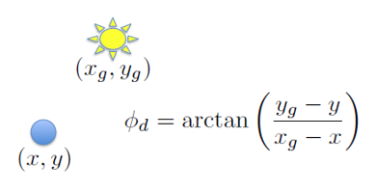
Activity A.5 Go-To-Angle & Go-To-Goal
Notes:
<object width="560" height="315"><param name="movie" value="//www.youtube.com/v/huQSWZX1Glo?hl=en_US&amp;version=3&amp;rel=0"></param><param name="allowFullScreen" value="true"></param><param name="allowscriptaccess" value="always"></param><embed src="//www.youtube.com/v/huQSWZX1Glo?hl=en_US&amp;version=3&amp;rel=0" type="application/x-shockwave-flash" width="560" height="315" allowscriptaccess="always" allowfullscreen="true"></embed></object>

Slide 2
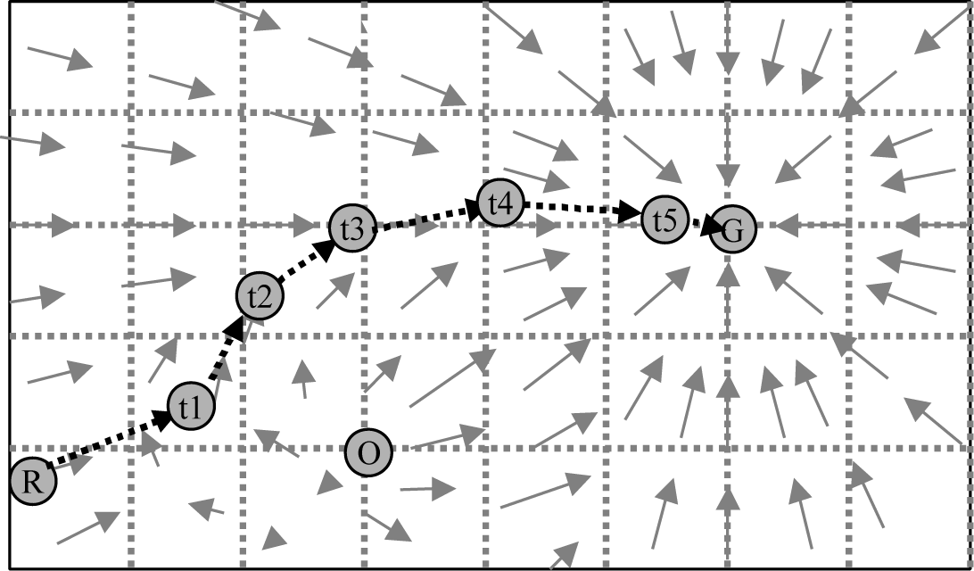
Activity A.5 Go-To-Goal & Obstacle Avoidance

Slide 3
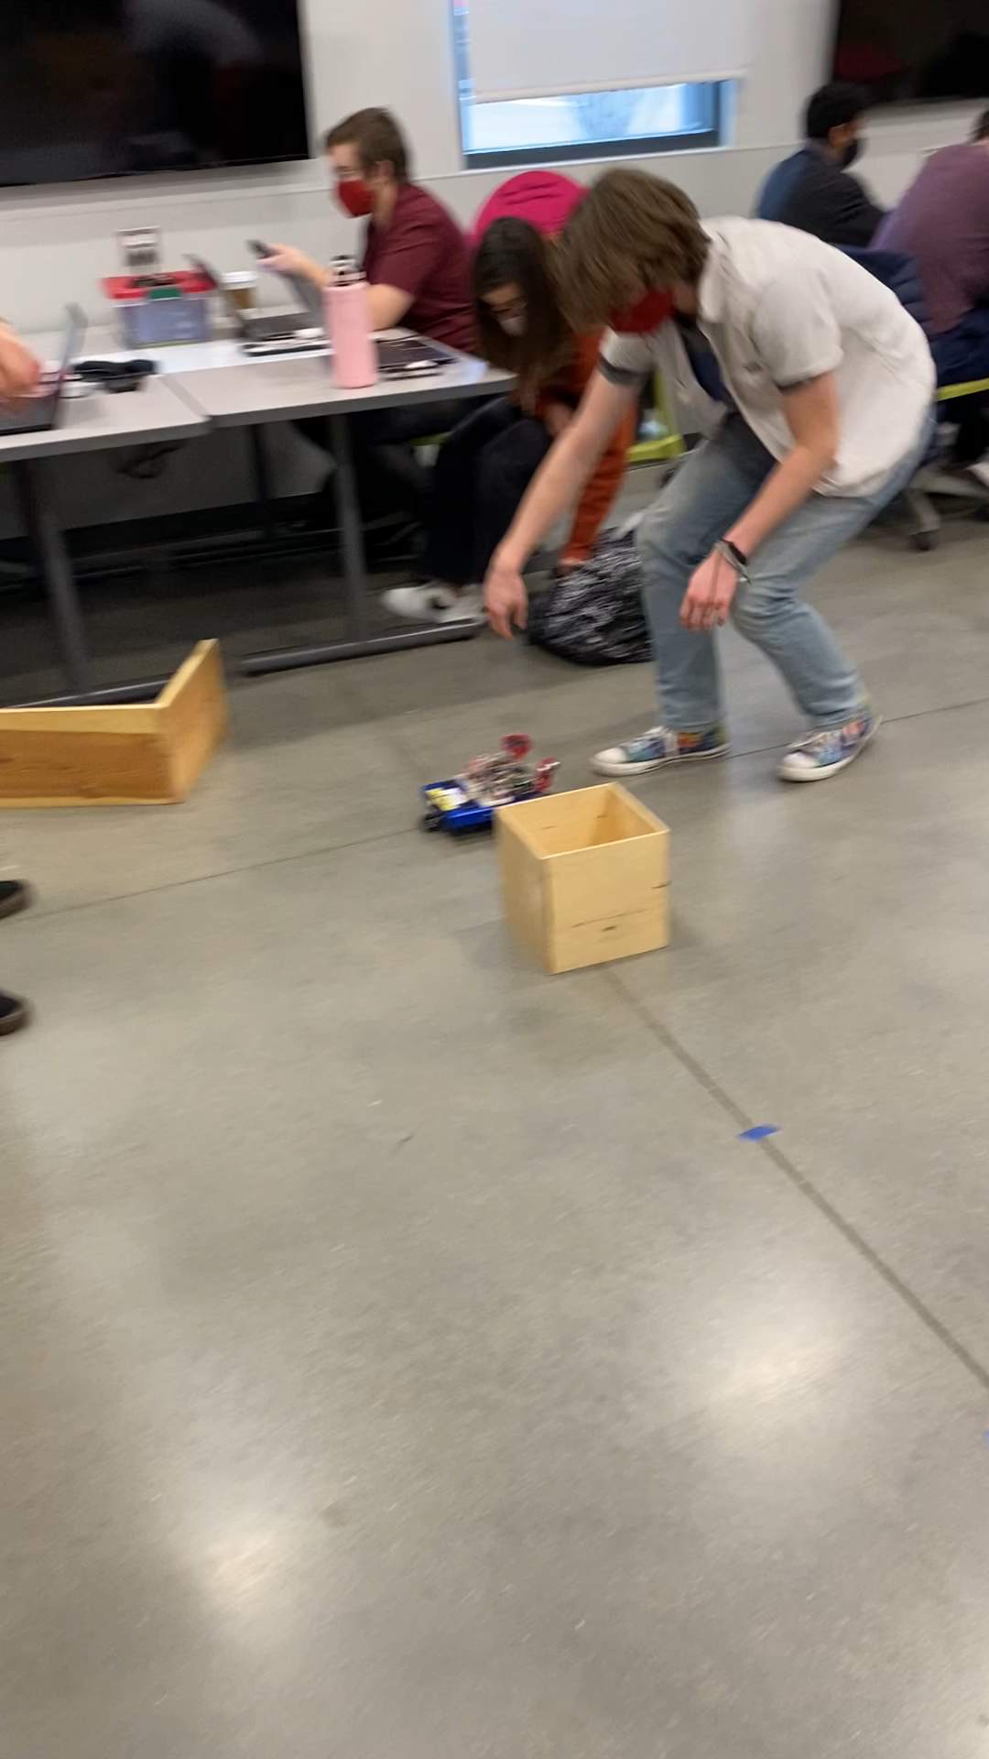
Go-To-Goal & Avoid-Obstacle Video

